Slide 1

Exploiting raspberry pi
(Running Raspbian OS)

Slide 2
What are we going to look at today?
How to scan your network and figure out what the machine’s IP address is.
How to SSH into this machine using port 22
Use Metasploit to set the payload and target the machine
Create the exploit and send it to the target machine and run a Python script that’ll allow the exploit to run
Gain access to the machine’s shell as root and escalate user privilege and change a user’s password without them knowing

Slide 3
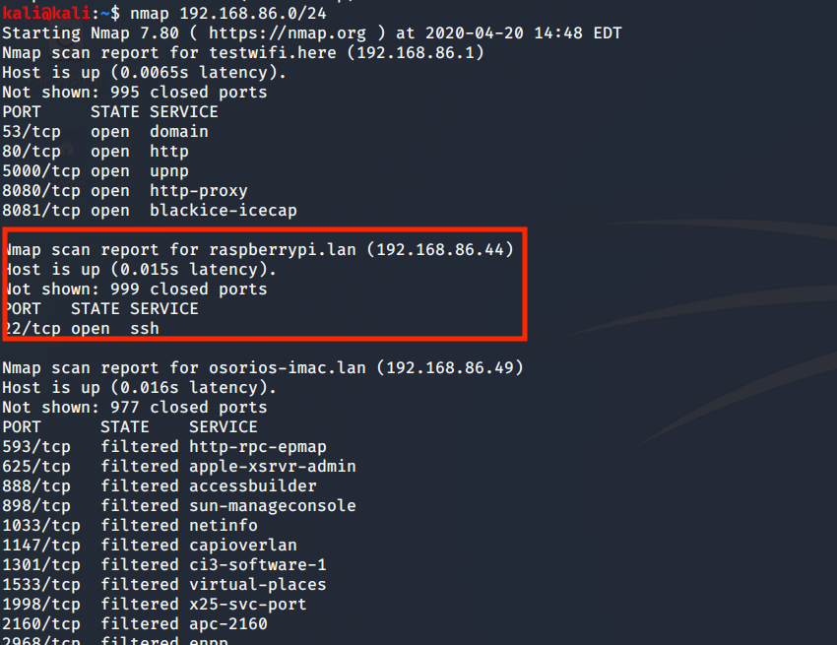
Running an nmap scan on my local lan

Slide 4
Actual payload

Slide 5
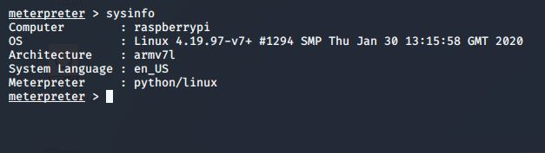
Getting information of the compromised system

Slide 6
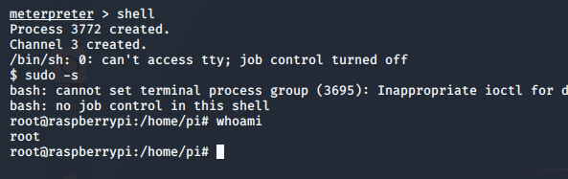
Gaining privileged access as root through shell

Slide 7
What does it mean if you now have root privileges?
You can do a lot of damage as a root user. You can change usernames, passwords, and even run miscellaneous background processes.

Slide 8
Why use the multi/handler/ exploit?
It uses a reverse shell payload to exploit.
Built into Metasploit itself
Uses port 4321to listen and connect back to the host machine
SCP command used to transfer the payload onto the raspberry Pi

Slide 9
What can we do to avoid such vulnerabilities?
Change the default user password
Close port 22 through firewall rules
Set up an IDS to alert you on such intrusions
Implement and harden user password policies

